Slide 1
Montessori Country Day School in Plainsboro
Register by April 20th & receive $25 off of each of the first 4 weeks of camp!
Kindergarten & Elementary
72 Grovers Mill Road, Plainsboro, NJ 08536• (609) 799-7990 • Montessori Corner.com

Slide 2
Welcome
About our Camp
Each week, children ages 5-12 jump into action, participating in exciting sports programs, exploring nature, becoming involved in performing and creative arts, playing a part in group activities, and attending special events.
Our campers expand their horizons, embark on new adventures, and most importantly have fun. Our exceptional program and dedicated staff create an environment that forges lifelong friendships among our campers. We create a summer experience that is unforgettable!
Our camp features a unique selection of indoor Montessori experiences and outdoor activities and field trips that take advantage of resources in the local area.
Our specialty camps are optional programs, operating during regular camp hours, which provide even more choices for unique and exciting adventures.
Hours
Monday-Friday 8:30 am - 3:30 pm
Extended Care 7:00 am - 6:30 pm
Schedule (no camp July 4)
Week 1 June 25 – 29
Week 2 July 2 – 6
Week 3 July 9 – 13
Week 4 July 16 – 20
Week 5 July 23 – 27
Week 6 July 30 – Aug 3
Week 7 Aug 6 – 10
Week 8 Aug 13 – 17
Week 9 Aug 20 – 24
Special Features
Quality staff
Flexible, extended hours
Field trips, special events
Air conditioned facility/bus
Indoor swimming pool
Lunch program
Family activities
Montessori Country Day School Summer SMARTS Camp 2018

Slide 3
Invention Convention Calling all inventors! We know our campers have big ideas and we want to see them in action. Invention Convention will focus on brainstorming, designing and sharing invention ideas.
Recycled Beautifully Our campers will see how one person's trash can be another person's treasure by turning recycled materials into beautiful and useful items.
Weeks 1 & 2
Digital Vision Campers explore the tools necessary to capture great images and videos, and refine them through digital imaging.
STEAM Academy Challenging and fun projects encourage collaboration, decision making, and innovation. Students work together to solve problems, while developing a love of science, technology, engineering, art, and math.
Weeks 3 & 4
Minute to Win It Campers will get a thrill from working together to complete fun, and sometimes silly, tasks all before time runs out on the clock. Ready, set, go!
Leave a Legacy Campers learn about how they can be heroes in their communities, and find creative ways to give back to those in need.
Weeks 5 & 6
Express Yourself Let your hidden talents shine! Campers develop creativity and confidence through singing, dancing, acting and more.
Game Changer We hope our campers are ready for some good old fashioned fun. They’ll have a blast building their skills in a variety of indoor and outdoor games.
Weekly Activity Themes
Weeks 7 & 8
Rise Up Dream it. Build it. Wreck it. Repeat! Campers build elaborate objects, structures and vehicles, while exploring fundamental principles of engineering and physics.
Week 9
Montessori Country Day School Summer SMARTS Camp 2018

Slide 4
After School Camp Clubs (3:30-4:30pm)
Art (Monday)
Mrs. Monteleone will provide small group art lessons to campers as they build their portfolios. Experience in a variety of mediums will enhance each artist’s skills and creativity.
$22/Per Week
$22/Per Week
Soccer Shots (Thursday)
Soccer Shots is the leader in youth soccer development for children ages 3-8. With over 160 locations across North America, they are focused on positively impacting children’s lives and the communities we serve.
$22/Per Week
Amazing Athletes (Tuesday)
Coach Terry will return to support our students’ development of amazing athletic skills. Children will develop capabilities in coordination and strengthen their confidence and competences in movement and sports.
$22/Per Week
STEAM Works (Friday)
Build, Create, & Innovate! Explore electronics & fun, squishy circuits! Campers will get an introduction to coding, robotics, and chemistry.
$22/Per Week
Cooking (Wednesday)
Campers will learn the basics of cooking & baking during this summer session! Campers will take home a recipe card at the end of each session!
Montessori Country Day School Summer SMARTS Camp 2018

Slide 5
A Day in the Life of a Camper
Sample Camp Schedule
7:00 – 8:30 am Before Care
8:30 – 9:00 am Morning Assembly Meeting
9:00 – 11:00 am Montessori Classroom Time
11:00 – 12:00 pm PE & Lunch
12:00 – 3:00 pm Work Time & Enrichments
3:00 – 3:30 pm Outdoors & Dismissal
3:30 – 4:30 pm AS Camp Clubs
4:30 – 6:30 pm After Care
Montessori Country Day School Summer SMARTS Camp 2018

Slide 6
2018 Tuition & Fee Schedule
Select Camp Weeks (no camp on July 4)
Tuition & Fees*
Week 1 June 25 – 29
Week 2 July 2 – 6
Week 3 July 9 – 13
Week 4 July 16 – 20
Week 5 July 23 – 27
Week 6 July 30 – August 3
Week 7 August 6 – 10
Week 8 August 13 – 17
Week 9 August 20 – 24
 | Weekly Cost | # of Weeks | Total Cost
Camp Tuition | $275.00
Swim Lessons | $50.00
Transportation | $90 RT/ $50 OW
Extended Day | $100
Payment Policy: One week’s tuition is due at time of enrollment as a deposit. We will apply the deposit to the final week of camp. Weekly camp fees are due every Monday morning by 9am. We will charge a $25 late fee if payment is not received by 12 pm Tuesday.
Schedule Policy:
Use the chart on the following page to select your child’s weekly summer schedule. Please indicate the weeks your child will be attending camp as well as any additional activities your are selecting for them. Two weeks notice MUST be given for a change of schedule otherwise you will be charged accordingly. For example, if you schedule your child for a week of camp and you do not give two week’s notice of your cancellation, then you will still be charged for that week.
*I understand and accept the payment policy & schedule policy.
Parent Signature: _______________________________________
Date:____________________
Camper Information
Name: ______________________
Date of Birth: _________________
Shirt Size (Y XS – Adult M): _______
# of Shirts** __________
**Each camper receives one t-shirt with camp registration. Additional shirts are available for $15 each.
Montessori Country Day School Summer Camp 2018

Slide 7
2018 Tuition & Fee Schedule
 |  | Swim Lessons $50/week | B&A Care $100/week | Bus Service $90 RT $50 OW | After School Clubs |  |  |  |  | Total
Select Weeks | Select Camp Weeks |  |  |  | Art $22/week | Amazing Athletes $22/week | Cooking $22/week | Soccer $22/week | STEAM $22/week
 | Week 1 June 25 – 29
 | Week 2 July 2 – 6
 | Week 3 July 9 – 13
 | Week 4 July 16 – 20
 | Week 5 July 23 – 27
 | Week 6 July 30 – Aug 3
 | Week 7 Aug 6 – 10
 | Week 8 Aug 13 – 17
 | Week 9 Aug 20 – 24
No Camp
July 4th
Weekly camp tuition is $275 per week. The camp tuition for Week 2 is $220 due to the camp closure on Wednesday, July 4th Week 2’s BA Care Rate is $80, the Swim Rate is $40. The week 2 rates are not applicable to any other week of camp.

Slide 8
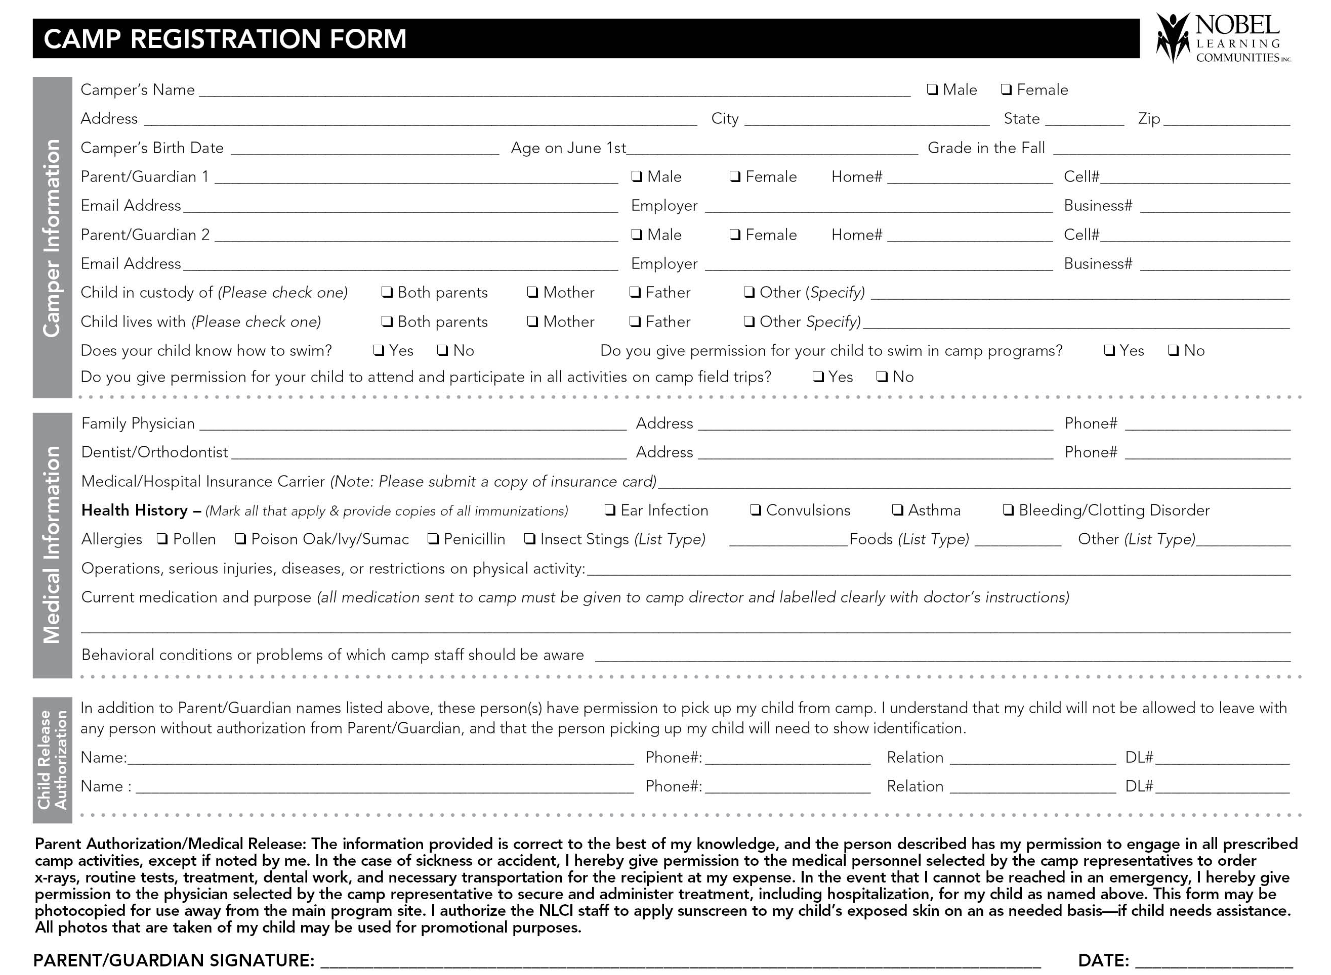
Montessori Country Day School Summer SMARTS Camp 2018

